Slide 2
Java Script
JavaScript is a versatile, dynamically typed programming language that brings life to web pages by making them interactive. It is used for building interactive web applications, supports both client-side and server-side development, and integrates seamlessly with HTML, CSS, and a rich standard library.
Single Threaded Language so one task at a time

Slide 3
Object Oriented
Platform Independent
Update HTML using DOM
Capable of Exception Handling
Allows Anonymous Functions
The data type of the variable is decided at run-time in JavaScript, which is why it is called dynamically typed.

Slide 4
<html>
<head></head>
<body>
<h1>Check the console for the message!</h1>
<script>
// This is our first JavaScript program
console.log("Hello, World!");
</script>
</body>
</html>
console.log() prints messages to the browser's developer console. Open the browser console to see the "Hello, World!" message.

Slide 5
JavaScript's flexibility extends to both the client-side and server-side, allowing developers to create complete web applications. Here’s how it functions in each environment:
Client-Side:
Involves controlling the browser and its DOM (Document Object Model).
Handles user events like clicks and form inputs.
Common libraries include AngularJS, ReactJS, and VueJS.
Server-Side:
Involves interacting with databases, manipulating files, and generating responses.
Node.js and frameworks like Express.js are widely used for server-side JavaScript, enabling full-stack development.

Slide 6
JavaScript was created in 1995 by Brendan Eich.
In 1997, JavaScript became a standard, known as ECMAScript

Slide 7
JavaScript syntax refers to the rules and conventions dictating how code is structured and arranged within the JavaScript programming language. This includes statements, expressions, variables, functions, operators, and control flow constructs.

Slide 8
Variable’s
Syntax
var a = 10;
let data = ‘Hello’;
const fixed = ‘3.14’;

Slide 9
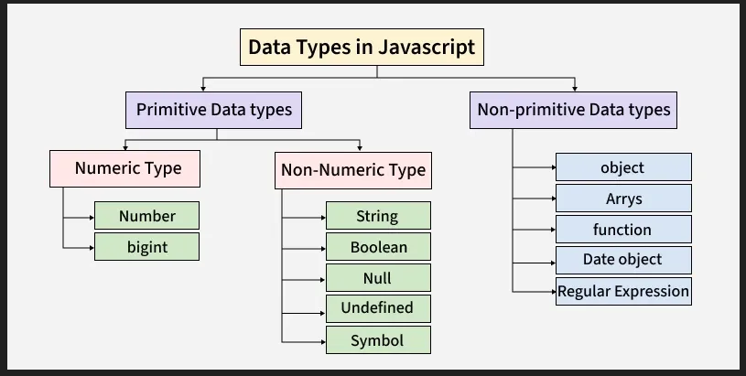

Slide 10
let obj = { name: "Amit", age: 25 };
let a = ["red", "green", "blue"];

Slide 11
There are different types of JavaScript operators:
Arithmetic Operators
Assignment Operators
Comparison Operators
Logical Operators

Slide 12
Functions
Declaration
function <function name> (){ }
function call() { }
function call (a1 , a2) { }
function call (a3 , a4) { return (a3+a4); }

Slide 13

Arrays
let a = [];
let b = [10, 20, 30];
let a = new Array(10, 20, 30);
console.log(a);

Slide 14
Operations on Array
To get the Length of Array we have length property in JavaScript
We can assign value to array using index
b[2] = 12;

Slide 15
Math.abs(-4.7): 4.7
Math.ceil(4.4): 5
Math.floor(4.7): 4
Math.sin(90 * Math.PI / 180): 1
Math.min(0, 150, 30, 20, -8, -200): -200 Math.random(): 0.7416861489868538

Slide 16
A Map is a data structure that stores key-value pairs, where each key is unique. It is similar to an object but has some advantages:
Inserts keys in the order they were added.
Allows keys of any type, not just strings and symbols.
Provides better performance when dealing with large datasets.

Slide 17
set(key, val) : Adds or updates an element with a specified key and value.
get(key) : Returns the value associated with the specified key.
has(key) : Returns a boolean indicating whether an element with the specified key exists.
delete(key) : Removes the element with the specified key.
clear(): Removes all elements from the Map.
size: Returns the number of key-value pairs in the Map.

Slide 18
A Set in JavaScript is used to store a unique collection of items, meaning no duplicates are allowed.
Sets internally use a hash table which makes search, insert and delete operations faster than arrays. Please note that a hash table data structure allows these operations to be performed on average in constant time.
Set maintains the insertion of items. When we access items, we get them in the same order as inserted.
Only unique values are allowed. If you try to add a duplicate value, it will be ignored.
A set can be created either empty or by providing an iterable like array or string.

Slide 19
Array is an Object in JavaScript so we have in build methods to add , remove , display data of array
push() - add the element to the end of the array.
unshift() - add the element to the starting of the array.
pop() - removes an element from the last index of the array.
shift() - removes the element from the first index of the array.
splice() -removes or replaces the element from the array.
Iterating Array - for loop
for (let i = 0; i < a.length; i++) {
console.log(a[i])
}

Slide 20
a.forEach(function myfunc(x) {
console.log(x);
});
for (const i in a) {
console.log(a[i]);
}

Slide 21
JavaScript Program to calculate sum of Array Elements
JavaScript Program to Find Largest Element in an Array

Slide 22
The JavaScript Array.reduce() method iterates over an array, applying a reducer function to each element, accumulating a single output value. It takes an initial value and processes elements from left to right, reducing the array to a single result. It is useful for doing operations like max in an array, min in an array and sum of array

Slide 23
array.reduce( function(total, currentValue, currentIndex, arr), initialValue )
Return value:
The JavaScript array reduce method returns a single value/element after traversing the complete array.
Parameters:
This method accepts five parameters as mentioned above and described below:
function(total, currentValue, index, arr): It is the required parameter and is used to run for each element of the array. It contains four parameters which are listed below:
initialValue: It is an optional parameter and is used to specify the value to be passed to the function as the initial value.

Slide 24
lambda
A lambda expression also known as arrow-function is a function without a name defined using the arrow => syntax introduced
const functionName = (parameters) => { // function body };
let mul = (a, b) => a * b;
console.log(mul(5, 9));

Slide 25
String
const str1 = new String(“IET");
const str2 = “IET";
Strings are Immutable
String internally consider as array only
String are predefined in JS we have many library functions to work on String

